Slide 1
Hbase ORM framework
Simplehbase Getting Started in 3 minutes
https://github.com/zhang-xzhi/simplehbase
xinzhi.zhang@alipay.com
V0.1
2014-03-04

Slide 2
What is simplehbase
Simplehbase is a lightweight ORM framework between java app and hbase. The main feature of it are following:
data type mapping: mapping java type to hbase's bytes back and forth.
hbase operation wrapping: warpping hbase's put get scan operation to simple java interface.
hbase query language: using hbase filter, simplehbase can use sql-like style to operate on hbase.
dynamic query: like myibatis, simplehbase can use xml config file to define dynamic query to operate on hbase.
insert update support: provide insert, update on top of checkAndPut.
multiple version support: provide interface to operation on hbase's multiple version.
hbase native interface support.

Slide 3
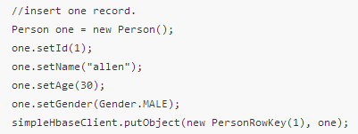
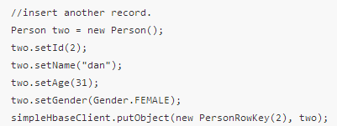
Java code fragment - put

Slide 4


Java code fragment - search

Slide 5
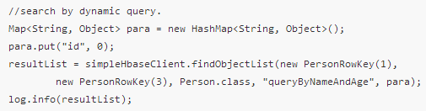
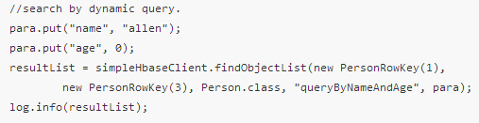
Java code fragment - dynamic query

Slide 6

Java code fragment - delete

Slide 7
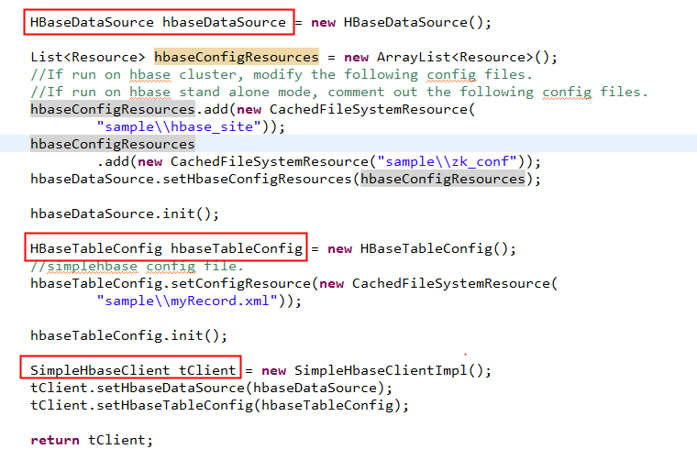
How to get SimpleHbaseClient

Slide 8
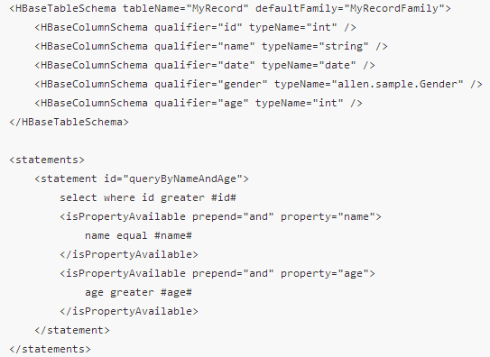
Config xml’s peek

Slide 9
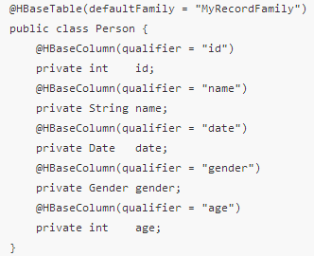
What do we need to do with DO

Slide 10
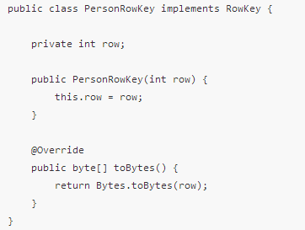
What is rowkey

Slide 11
More on github
https://github.com/zhang-xzhi/simplehbase
https://github.com/zhang-xzhi/simplehbase/wiki

